Slide 1
The Transport Layer
Chapter 6

Slide 2

The Transport Service
The transport layer is at the heart of the whole protocol hierarchy.
It’s task is to provide a reliable, cost-effective data transport from the source machine to the destination machine, independent of the physical networks in use.
  Services Provided to the Upper Layers
  Transport Service Primitives
  Berkeley Sockets

Slide 3
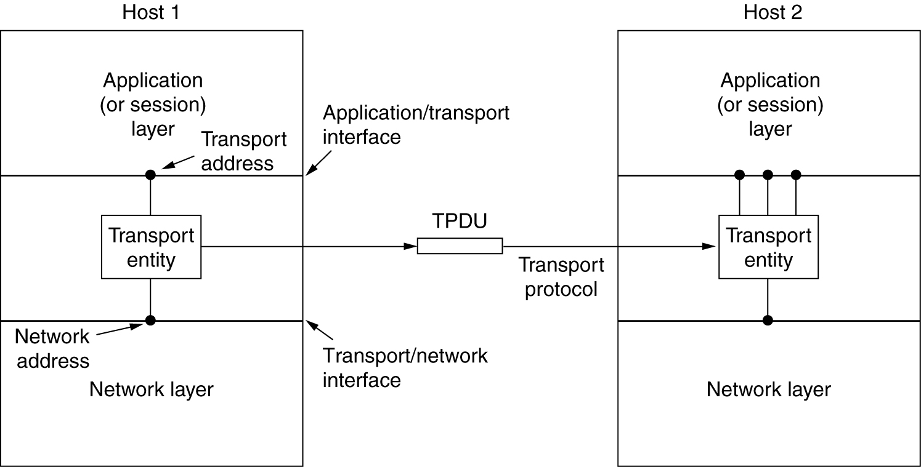

Services Provided to the Upper Layers
The hardware and/or software within the transport layer that does the work is called the transport entity.
The transport entity can be in:
the operating system kernel,
a separate user process,
a library package bound into network applications,
the network interface card, or
special interface machines at the edge of the subnet to which hosts connect.

Slide 4
Types of Transport Service
There are two types of transport services: connection-oriented and connectionless, similar to the corresponding network services.
Why are there two distinct layers, i.e., network and transport layers ?
Network layer is part of the communication subnet and is run by the carriers. What if the network layer offers unreliable service?
Since the users have no control over the subnet, the only possibility is to put another layer on top of the network layer that improves the quality of the service.
The transport service primitives can be designed to be independent of the network service primitives, which may vary considerably from network to network.
The bottom four layers can be seen as the transport service provider, whereas the upper layers are the transport service user.

Slide 5
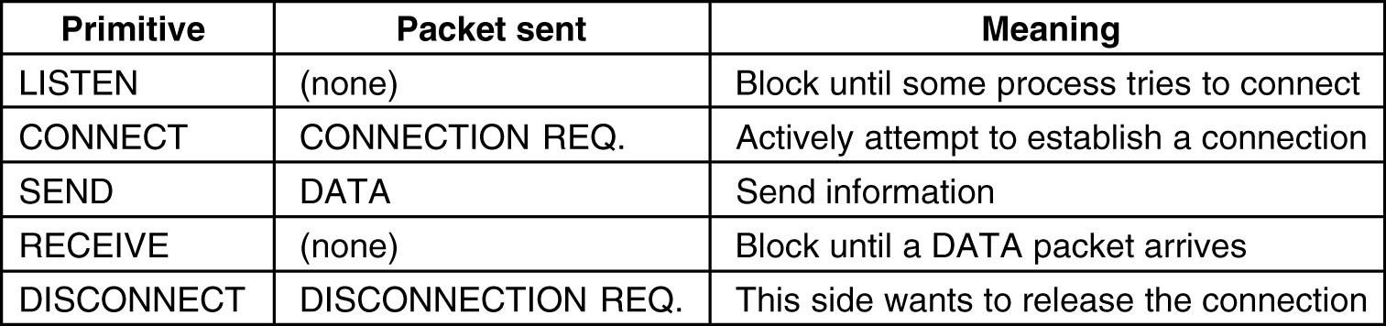

Transport Service Primitives
The transport service primitives allow application programs to access the transport service.
To get an idea of what a transport service might be like, consider the five primitives for a simple transport service listed in the following figure.

Slide 6
An Example of Using Transport Service Primitives (1)
To see how these transport primitives might be used, consider an application with a server and a number of remote clients.
Connection establishment:
The server executes a LISTEN primitive, which blocks the server until a client turns up.
A client executes a CONNECT primitive, which blocks the client, and sends a packet (encapsulating a CONNECTION REQUEST TPDU) to the server via the underlying network layer.
When the packet arrives at the server side, the transport entity checks to see that the server is blocked on a LISTEN (i.e., interested in handling requests). It then unblocks the server and sends a CONNECTION ACCEPTED TPDU back to the client.
When this TPDU arrives at the client side, the client is unblocked and the connection is established.

Slide 7
An Example of Using Transport Service Primitives (2)
Data exchange:
Either party can do a (blocking) RECEIVE to wait for the other party to do a SEND.
When the DATA TPDU arrives, the receiver is unblocked.
As long as both sides can keep track of whose turn it is to send, this scheme works fine.
Every packet sent will be (eventually) acknowledged. These acknowledgements, timers, and re-transmissions are managed by the transport entities using the network layer protocol and are not visible to the transport users.
Connection release:
Asymmetric disconnection: either transport user can issue a DISCONNECT primitive, which results in a DISCONNECT TPDU being sent to the remote transport entity. Upon arrival, the connection is released.
Symmetric disconnection: When one side does a DISCONNECT, that means it has no more data to send, but is still willing to accept data from its partner. A connection is released when both sides have done a DISCONNECT.

Slide 8

Elements of Transport Protocols
Addressing
Connection Establishment
Connection Release
Flow Control and Buffering

Slide 9


Transport Protocol
Transport protocols resemble the data link protocols: error control, sequencing, and flow control. There are major dissimilarities between the environments in which the two protocols operate, as shown in the following figure.
Environment of the data link layer. Environment of the transport layer.
  In the data link layer, it is not necessary for a router to specify which router it wants to talk to. In the transport layer, explicit addressing of destination is required.
  Initial connection setup is much more complicated in transport layer.
  The potential existence of storage capacity in the subnet requires special transport protocols.
  Buffering and flow control are needed in both layers, but the presence of a large and dynamically varying number of connections in the transport layer may require a different approach than the data link layer approach (e.g., sliding window buffer management).

Slide 10
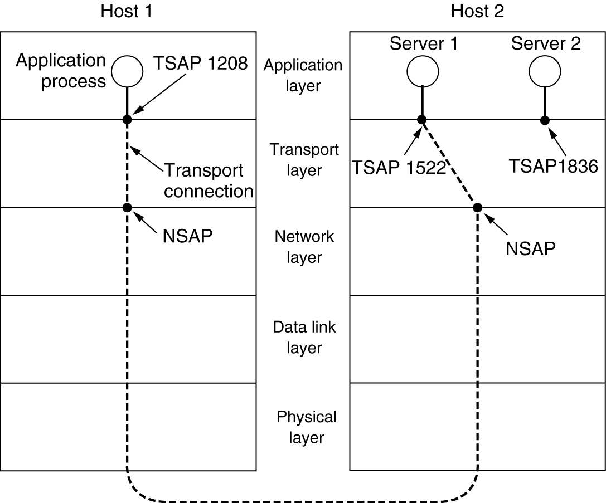

Addressing
How to specify the transport users ?
The method normally used is to define transport addresses to which processes can listen for connection requests.
  In Internet, these end points are (IP address, local port) pairs.
  In ATM networks, they are AAL-SAPs.
We will use the neutral term TSAP (Transport Service Access Point).
TSAPs, NSAPs and transport connections.

Slide 11


Connection Establishment – the Problem
The problem with establishing a connection occurs when the subnet can lose, store, and duplicate packets.
Consider the following scenario:
  A user establishes a connection with a bank,
  sends messages telling the bank to transfer a large amount of money to the account of a not entirely trustworthy person,
  and then release the connection.
What happens if each packet in the above process is duplicated and stored in the subnet ?
After the connection has been released, all the packets pop out of the subnet and arrive at the destination in order, asking the bank to establish a new connection, transfer money (again), and release the connection. The bank has no way of telling that these are duplicates !
How to deal with the problem of delayed duplicated and establish connections in a reliable way ?

Slide 12
Connection Establishment – Solutions (1)
Method 1: use throwaway TSAP addresses.
  Each time a TSAP address is needed, a new, unique address is generated, typically based on the current time.
  When a connection is released, the addresses are discarded forever.
This strategy makes the process server model impossible.
Method 2:
  Each connection is assigned a connection identifier (i.e., a sequence number incremented for each connection established), chosen by the initiating party, and put in each TPDU, including the one requesting the connection.
  After each connection is released, each transport entity could update a table listing obsolete connections as (peer transport entity, connection identifier) pair.
  Whenever a connection request came in, it could be checked against the table, to see if it belonged to a previously released connection.
What happens if a machine crashes and loses its memory ?

Slide 13
Connection Establishment – Solutions (2)
Method 3
The basic idea is to ensure that two identically numbered TPDUs are never outstanding at the same time.
If we can ensure that no packets lives longer than some known time, the problem becomes somewhat more manageable.
Mechanisms to kill off old packets that are still wandering about:
  Restricted subnet design. Any method preventing packets from looping.
  Putting a hop counter in each packet.
  Time stamping each packet.
Let T be some small multiple of the true maximum packet lifetime. T is protocol-dependent. If we wait a T time after a packet has been sent, we can be sure that all traces of it (the packet and its acknowledgement) are gone.

Slide 14
Connection Establishment – Solutions (3)
The problem of crashing and losing memory problem can be solved with a clock with the following properties:
  Each clock takes the form of a binary counter that increments itself at uniform intervals.
  The number of bits in the counter must equal or exceed the number of bits in the sequence numbers.
  The clock survives the host crashes.
  The clocks at different hosts need not be synchronized.
How to number TPDUs ?
When a connection is set up, the low-order k bits of the clock are used as the initial sequence number (also k bits). So each connection starts numbering its TPDUs with a different sequence number.
The sequence space should be so large that by the time sequence numbers wrap around, old TPDUs with the same sequence number are long gone.

Slide 15


Connection Establishment – Solutions (4)
1 : 69
1 : 70
1 : 70
69
60
Solution 1: a computer cannot reboot in T time after crashing to allow previous TPDUs to disappear.
In TCP, T = 120 seconds.
Solution 2: a more complex algorithm.

Slide 16

The Three-Way Handshake Establishment Protocol
Host 1
Host 2
Host 1
Host 2
Host 1
Host 2
CR (seq=x)
CR (seq=x)
CR (seq=x)
ACK (seq=y, ACK=x)
ACK (seq=y, ACK=x)
ACK (seq=y, ACK=x)
DATA (seq=x, ACK=z)
DATA (seq=x, ACK=y)
REJECT (ACK=y)
REJECT (ACK=y)
Three protocol scenarios for establishing a connection using a three-way handshake. CR denotes CONNECTION REQUEST.
(a) Normal operation,
(b) Old CONNECTION REQUEST appearing out of nowhere.
(c) Duplicate CONNECTION REQUEST and duplicate ACK.

Slide 17
Connection Release
Asymmetric release is abrupt and may result in data loss, as shown below.
Host 1
Host 2
CR
ACK
Data
Data
DR
One way to avoid data loss is to use symmetric release, in which each direction is released independently of the other one.
Host 1 says:" I am done. Are you done too ?”
If Host 2 responds: ”I am done too. Goodbye.”, the connection is released.
This way does not always work.

Slide 18


The Two-Army Problem
Blue Army #1
Blue Army #2
White Army
A white army is encamped in a valley.
On both of the surrounding hillsides are blue armies.
The white army is larger than either of the blue armies alone, but together blue armies are larger than the white army.
If either blue army attacks by itself, it will be defeated, but if the two blue armies attack simultaneously, they will be victorious.
The communication medium between the two blue armies is to send messengers on foot down into the valley, where they might be captured and the message lost.
The question is, does a protocol exist that allows the blue armies to win ?
The answer is there is NO such protocol exists.

Slide 19


Three-Way Handshake Combined with Timers (1)
Host 1
Host 2
Host 1
Host 2
DR
DR
DR
DR
Release
Release
ACK
ACK
Release
Release
(a) Normal case of a three-way handshake. (b) final ACK lost.

Slide 20
Three-Way Handshake Combined with Timers (2)
Host 1
Host 2
Host 1
Host 2
DR
DR
DR
DR
DR
DR
DR
……
……
Release
ACK
Release
Release
Release
(c) Response lost. (d) Response lost and subsequent DRs lost.
In theory, this protocol can fail if the initial DR and retransmissions are all lost. The sender will give up and delete the connection, while the other side knows nothing at all about the attempts to disconnect and is still fully active. This situation results in a half-open connection.
One way to kill off half-open connections: If no TPDUs have arrived for a certain number of seconds, the connection is automatically disconnected.

Slide 21
Flow Control and Buffering (1)
How connections are managed while they are in use ?
For flow control, a sliding window is needed on each connection to keep a fast transmitter from overrunning a slow receiver (the same as the data link layer).
Since a host may have numerous (e.g., 64) connections, it is impractical to implement the same data link buffering strategy (using dedicated buffers for each line).
  The sender should always buffer outgoing TPDUs until they are acknowledged.
  The receiver may not dedicate specific buffers to specific connections. Instead, a single buffer pool may be maintained for all connections. When a TPDU comes in, if there is a free buffer available, the TPDU is accepted, otherwise it is discarded.

Slide 22
Flow Control and Buffering (2)
As the traffic pattern changes, the transport protocol should allow a sending host to request buffer space at the other end. Alternatively, the receiver could tell the sender “I have reserved buffers for you.”
A general way to manage dynamic buffer allocation is to decouple the buffering from the acknowledgements.
Dynamic buffer management – a variable-sized window.
Initially, the sender requests a certain number of buffers, based on its perceived needs.
The receiver then grants as many of these as it can afford.
Every time the sender transmits a TPDU, it must decrement its allocation, stopping altogether when the allocation reaches zero.
The receiver then separately piggybacks both acknowledgements and buffer allocations onto reverse traffic.

Slide 23
Flow Control and Buffering (3)
Number of
Buffers
seq=2, data=m2
seq=1, data=m1
seq=3, data=m3
seq=6, data=m6
seq=5, data=m5
Request 8 buffers
seq=0, data=m0
seq=2, data=m2
ack=15, buf=4
seq=4, data=m4
ack=1, buf=3
ack=4, buf=0
ack=6, buf=4
ack=4, buf=1
ack=6, buf=0
ack=4, buf=2
1
3
4
2
0
A
B
To prevent deadlock caused by loss of control TPDUs, each host should periodically send control TPDUs giving the acknowledgement and buffer status on each connection.
The sender's window size could be dynamically adjusted not only by the availability of the buffers at the receiver side, but also by the capacity and traffic of the subnet: the bigger the subnet's carrying capacity and the lighter the traffic, the larger the sender's window (assuming buffer availability is no longer a problem).

Slide 24

The Internet Transport Protocols: UDP
Introduction to UDP (User Data Protocol)
Remote Procedure Call
The Real-Time Transport Protocol

Slide 25
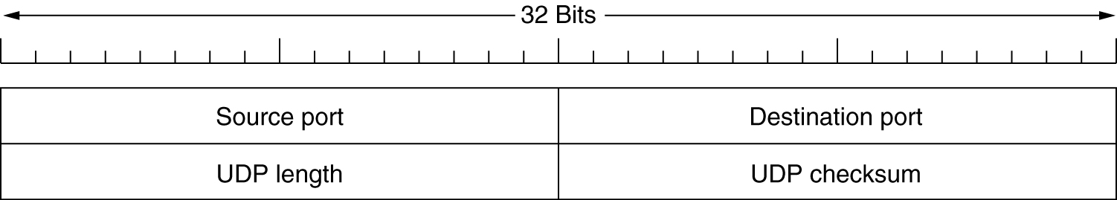
Introduction to UDP
UDP is a connectionless transport protocol used in Internet. It is a simply a user interface to IP.
Many client-server applications (e.g. DNS) that have one request and one response use UDP.
The UDP header.

Slide 26
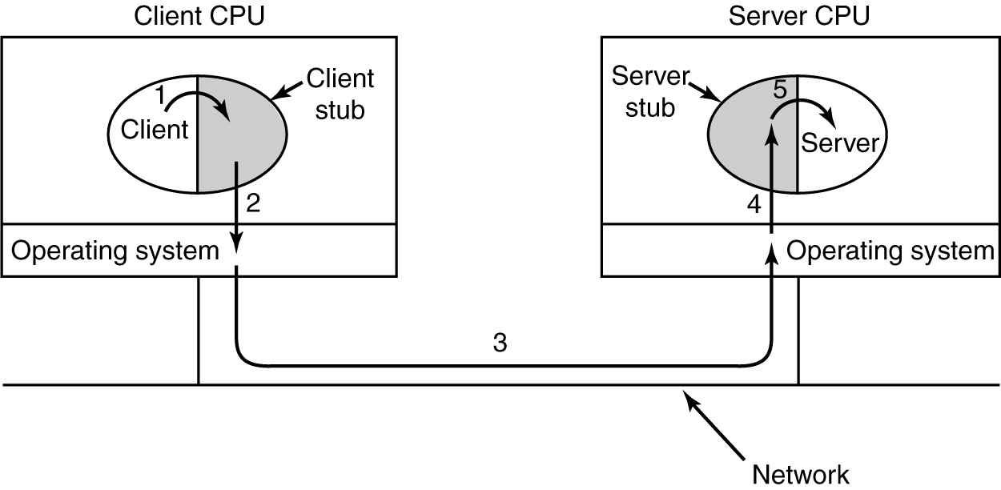
Remote Procedure Call
Steps in making a remote procedure call. The stubs are shaded.
RPC need not use UDP packets, but RPC and UDP are a good fit and UDP is commonly used for RPC.

Slide 27
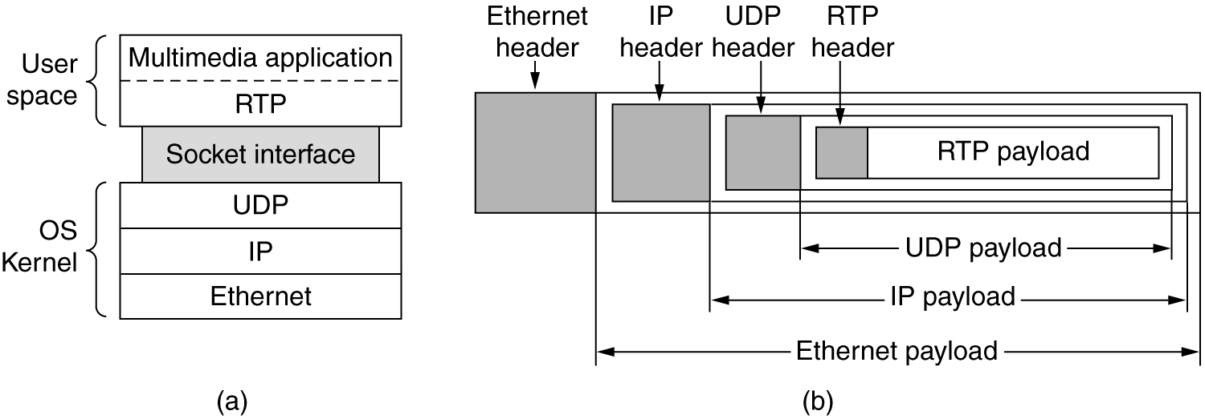
The Real-Time Transport Protocol
The Real-Time Transport Protocol (RTP) is implemented in the application layer, and commonly used by Internet radio, Internet telephony, music-on-demand, videoconferencing, video-on-demand, and other multimedia applications.
(a) The position of RTP in the protocol stack. (b) Packet nesting.

Slide 28

The Internet Transport Protocols: TCP
Introduction to TCP
The TCP Service Model
The TCP Protocol
The TCP Segment Header
TCP Connection Establishment
TCP Connection Release
TCP Transmission Policy
TCP Congestion Control
TCP Timer Management
Wireless TCP and UDP

Slide 29

The Internet Transport Protocols: TCP
TCP (Transmission Control Protocol) was specifically designed to provide a reliable end-to-end byte stream over an unreliable internetwork.
Each machine supporting TCP has a TCP entity, either a user process or part of the OS kernel that manages TCP streams and interfaces to the IP layer.
  A TCP entity accepts user data streams from local processes, breaks them up into pieces not exceeding 64K bytes (in practice, usually about 1460 bytes in order to fit in a single Ethernet frame with the IP and TCP headers), and sends each piece as a separate IP datagram.
  When IP datagrams containing TCP data arrive at a machine, they are given to the TCP entity, which reconstructs the original byte streams.

Slide 30
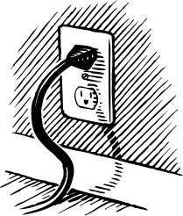
The TCP Service Model (1)
TCP service is obtained by having both the sender and receiver create end points, called sockets.
Each socket has a number (address) consisting of the IP address of the host and a 16-bit number local to that host, called port.
Port numbers below 256 are called well-known ports and are reserved for standard services. E.g.:
Port
Protocol
Use
21
FTP
File transfer
23
Telnet
Remote login
25
SMTP
E-mail
69
TFTP
Trivial File Transfer Protocol
79
Finger
Lookup info about a user
80
HTTP
World Wide Web
110
POP-3
Remote e-mail access
119
NNTP
USENET news
Some assigned ports.

Slide 31
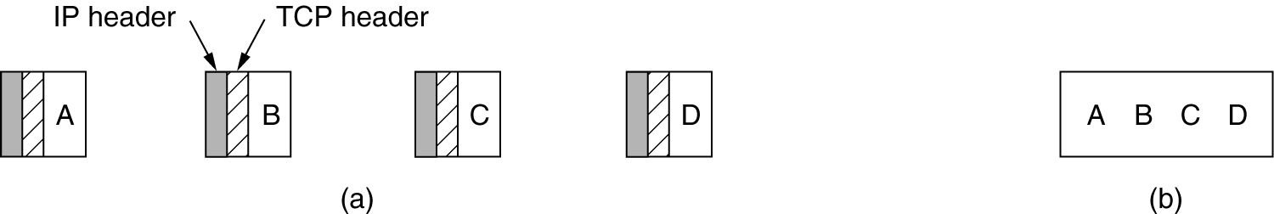
The TCP Service Model (2)
All TCP connections are full-duplex and point-to-point (which means each connection has exactly two end points).
TCP does not support multicasting or broadcasting.
A TCP connection is a byte stream, not a message stream.
(a) Four 512-byte segments sent as separate IP datagrams.
(b) The 2048 bytes of data delivered to the application in a single READ CALL.

Slide 32

Buffering and Urgent Data Service
TCP has internal buffers to collect a larger amount to send at once. To force data out, applications can use the PUSH flag to tell TCP not to delay the transmission.
The urgent data service (or signalling mechanism):
  When an interactive user hits the DEL, the sending application puts some control information in the data stream and gives it to TCP along with the URGENT flag.
  The event causes TCP to stop accumulating data and transmit everything it has for that connection immediately. The end of the urgent data is marked, but the start of it is not.
  When the urgent data are received at the destination, the receiving application is interrupted (e.g., given a signal in UNIX terms), so it can stop whatever it was doing and read the data stream to find the urgent data.

Slide 33

The TCP Protocol
Every byte on a TCP connection has its own 32-bit sequence number.
The sending and receiving TCP entities exchange data in the form of segments.
A segment consists of a fixed 20-byte header (plus an optional part) followed by zero or more data bytes.
The TCP software decides how big segments should be. Two limits restrict the segment size:
  Each TCP segment must fit in the 65,535 bytes IP payload.
  Each TCP segment must fit in the MTU (Maximum Transfer Unit) of the underlying network (e.g., 1500 bytes – the Ethernet payload size).
The basic protocol used by TCP entities is the sliding window protocol, which deals with the following issues:
  Error and flow control: timeout, retransmission, and acknowledgment.
  Byte stream order preservation.
  Congestion control.

Slide 34
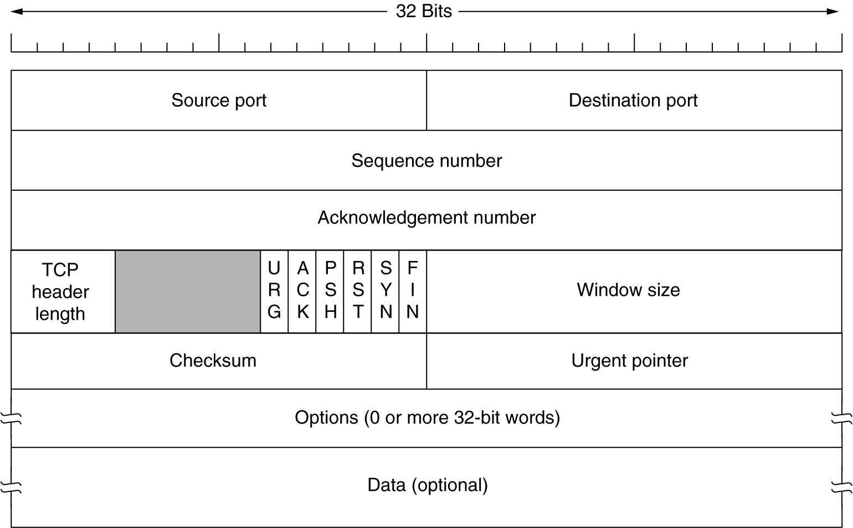
The TCP Segment Header (1)

Slide 35
The TCP Segment Header (2)
  URG is set to 1 if urgent pointer is in use, which indicates a byte offset from the current sequence number at which urgent data are to be found.
  ACK is set to 1/0 to indicate that the Acknowledgment number is valid or invalid.
  PSH indicates PUSHed data. The receiver is requested to deliver the data to the application upon arrival and not buffer it until a full buffer has been received.
  SYN is used to denote CONNECTION REQUEST and CONNECTION CONFIRM, with the ACK used to distinguish between those two possibilities.
  RST is used to reset a connection that has become confused due to delayed duplicate SYNs or host crashes.
  FIN is used to release a connection. It specifies that the sender has no more data to transmit, but may continue to receive data indefinitely.

Slide 36

TCP Connection Establishment (1)
Three-way handshake protocol is used by TCP to deal with the problem of delayed duplicates when attempting to establish a connection.
To establish a connection:
One side, say the server, passively waits for an incoming connection by executing the LISTEN and ACCEPT primitives, either specifying a specific source or nobody in particular.
The other side, say the client, actively executes a CONNECT primitive, specifying the IP address and port to which it wants to connect, the maximum TCP segment size, and optionally some user data (e.g., a password).
The CONNECT primitive sends a TCP segment with the SYN bit on and ACK bit off and waits for a response.
When this segment arrives at the destination, the TCP entity there checks to see if there is a process that has done a LISTEN on the port given in the Destination port field. If not, it sends a reply with the RST bit on to reject the connection.
If some process is listening to the port, that process is given the incoming TCP segment. It can then either accept or reject the connection.
If the connection request is accepted, an acknowledgment is sent back.

Slide 37
TCP Connection Establishment (2)
Host 1
Host 2
Host 1
Host 2
SYN (SEQ=x)
SYN (SEQ=x)
SYN (SEQ=y)
SYN (SEQ=y, ACK=x+1)
SYN (SEQ=y, ACK=x+1)
(SEQ=x+1, ACK=y+1)
SYN (SEQ=x, ACK=y+1)
(a) TCP connection establishment in the normal case. (b) Call collision.
A clock-based scheme is used for sequencing, with a clock tick every 4usec.
When a host crashes, it may not reboot for the maximum packet lifetime (120 sec) to make sure that no packets from previous connections are still roaming around the Internet somewhere.

Slide 38
TCP Connection Release
To release a connection:
Either party can send a TCP segment with the FIN bit set, which means that it has no more data to transmit.
When the FIN is acknowledged, that direction is shut down.
When both directions have been shut down, the connection is released.
To avoid the two-army problem, timers are used:
If a response to a FIN is not forthcoming within two maximum packet lifetimes, the sender of the FIN releases the connection.
The other side will eventually notice that nobody seems to be listening to it any more, and time out as well.

Slide 39
TCP Transmission Policy (1)
Sender
Receiver
Receiver’s buffer
Application does a 2K write
0 4K
2K
SEQ=0
2K
ACK=2048, WIN=2048
Application does a 2K write
2K
SEQ=2048
Full
Application does a 2K read
Sender is blocked
ACK=4096, WIN=0
2K
ACK=4096, WIN=2048
Application does a 1K write
1K
SEQ=4096
1K
2K

Slide 40

TCP Transmission Policy (2)
When the window is 0, the sender may not normally send segments, with two exceptions:
  Urgent data may be sent, for example, to allow the user to kill the process running on the remote machine.
  The sender may send a 1-byte segment to make the receiver re-announce the next byte expected and window size (in order to prevent deadlock if a window announcement ever gets lost).
Senders are not required to transmit data as soon as they come in from the application. Neither are receivers required to send acknowledgments as soon as possible. This freedom can be exploited to improve performance.

Slide 41
TCP Transmission Policy (3)
Consider a TELNET connection to an interactive editor (running on a remote machine but displaying on a local screen) that reacts on every keystroke. In the worst case:
  When a character is typed, it is given to the sending TCP entity, which creates a 21-byte TCP segment, which the TCP gives to IP to send as a 41-byte IP datagram.
  At the receiving side (where the editor is running), TCP immediately sends a 40-byte acknowledgment (20 bytes of TCP header and 20 bytes of IP header).
  Later, when the editor has read the byte, TCP sends a window update, moving the window 1 byte to the right. This packet is also 40 bytes.
  Finally, when the editor has processed the character, it echoes it as a 41-byte packet (so that the character can be displayed on the local screen).
  In total, at least 162 bytes of bandwidth (without counting the data link layer overhead) are used and four segments are sent for each character typed.

Slide 42
TCP Transmission Policy (4)
How to optimize the receiver side ?
  The receiver can delay acknowledgments and window updates for 500 msec in the hope of acquiring some data on which to hitch a free ride.
How to optimize the sender side ?
Nagle's algorithm (1984):
When data come into the sender one byte at a time, just send the first byte and buffer all the rest until the outstanding byte is acknowledged.
Then send all the buffered characters in one TCP segment and start buffering again until they are all acknowledged.
A scenario in which it is better to disable the Nagle's algorithm: When an X-Windows application is being run over the Internet, mouse movements have to sent to the remote computer. Gathering them up to send in bursts makes the mouse cursor move erratically.

Slide 43
TCP Congestion Control
Although the network layer also tries to manage congestion, most of the heavy lifting is done by TCP because the real solution to congestion is to slow down the data rate.
The idea is not to inject a new packet into the network until an old one leaves. TCP attempts to achieve this goal by dynamically manipulating the window size.
Congestion detection: Based on the fact that packet loss due to transmission errors is rare because most long-haul trunks are fibre (wireless networks are a different story), all the Internet TCP algorithms assume that timeouts are caused by congestion and monitor timeouts for signs of trouble.
Congestion prevention: When a connection is established, a suitable window size has to be chosen. The receiver can specify a window based on its buffer size. If the sender sticks to this window size, problems will not occur due to buffer overflow at the receiving end, but they may still occur due to internal congestion within the network, as illustrated hydraulically in the next figure.

Slide 44
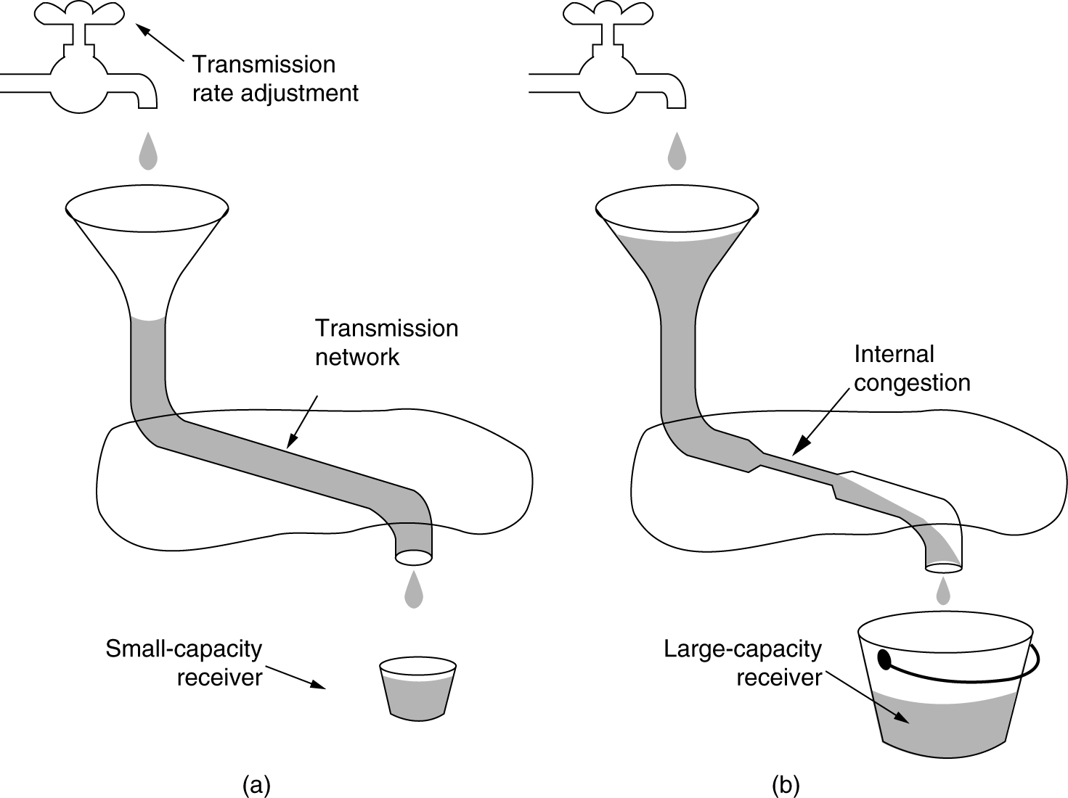
TCP Congestion Control
A fast network feeding a low capacity receiver.
A slow network feeding a high-capacity receiver.
The Internet solution is to realize that two potential problems exist - network capacity and receiver capacity - and to deal with each of them separately.
To do so, each sender maintains two window sizes:
  The receiver window size reflecting the receiver's current buffering capacity.
  The congestion window size reflecting the network current transmission capacity.
The number of bytes that may be sent is the minimum of the two window sizes.

Slide 45
The Slow Start Algorithm (1)
How to determine the congestion window size (i.e., the network transmission capacity) ?
The slow start algorithm:
  When a connection is setup, the sender initializes the congestion window to the size of the maximum segment in use on the connection.
  It then sends one segment. If this segment is acknowledged before timeout, it adds one segment's worth of bytes to the congestion window.
  When the congestion window is n segments, if all n segments are acknowledged on time, the congestion window is increased by the byte count corresponding to n segments.
  The congestion window keeps growing exponentially until either a timeout occurs or the receiver window is reached.

Slide 46
The Slow Start Algorithm (2)
  A third parameter, threshold, is used, initially 64K, in addition to the receiver and congestion window sizes.
  When a timeout occurs, the threshold is set to half of the current congestion window, and the congestion window is reset to one segment.
  The slow start algorithm is used to determine the network transmission capacity, except that exponential growth stops when the threshold is hit.
  From that point on, successful transmission grow the congestion window linearly (by one segment for each burst).

Slide 47
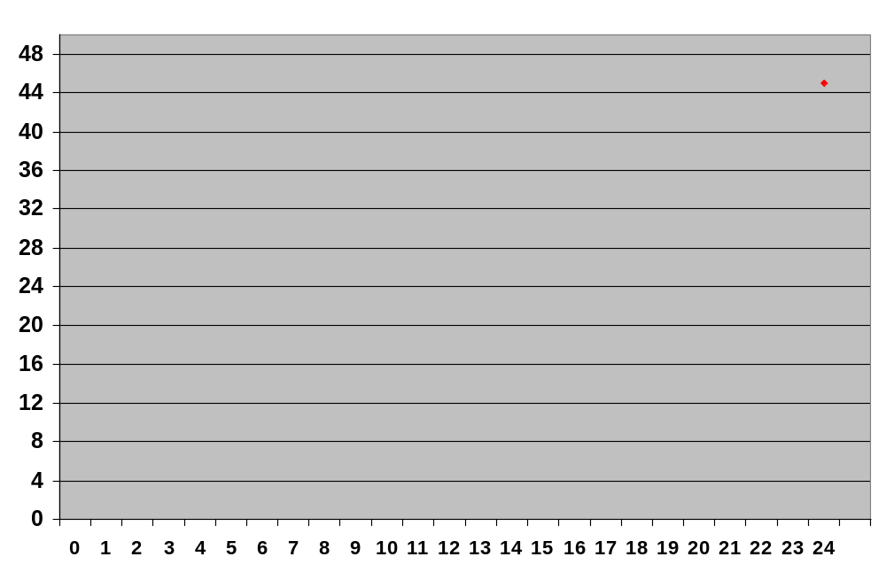
An Example of the Internet Congestion Algorithm
Congestion Window (kilobytes)
Threshold
Threshold
Transmission Number

Slide 48
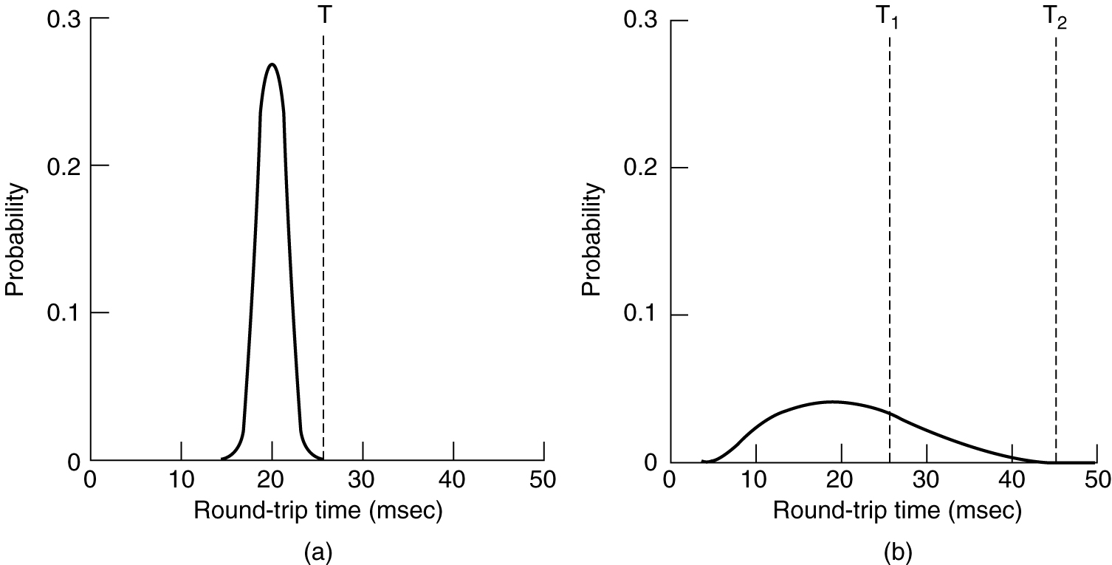
TCP Timer Management
The most important timer is the retransmission timer.
How long should the timeout interval be ?
(a) Probability density of ACK arrival times in the data link layer.
(b) Probability density of ACK arrival times for TCP.

Slide 49
Method for measuring round-trip time
In TCP, determining the round-trip time to the destination is tricky. Even when it is known, deciding on the timeout interval is also difficult.
The solution is to use a highly dynamic algorithm that constantly adjusts the timeout interval, based on continuous measurements of network performance.
Method for measuring round-trip time: (by Jacobson)
For each connection, TCP maintains a variable, RTT (Round-Trip Time).
When a segment is sent, a timer is started, both to see how long the acknowledgment takes and to trigger a retransmission if it takes too long.
If the acknowledgment gets back before the timer expires, TCP measures how long the acknowledgment took, say, M. It then updates RTT as follows: RTT = αRTT + (1 –α)M where α is a smoothing factor that determines how much weight is given to the old value. Typically α = 7/8.

Slide 50
Method for determining timeout interval
Initial TCP implementations chose
timeout_interval = β * RTT and β = 2.
Jacobson proposed an improved method for determining timeout interval:
  For each connection, TCP maintains an additional variable D (Derivation).
  Whenever an acknowledgement comes in, the difference between the expected and observed values, |RTT – M| is computed. A smoothed value of this is maintained in D by the formula
  D = α D + (1 - α) |RTT – M| where α may or may not be the same value used to smooth RTT.
  Most TCP implementations now set the timeout interval to
  timeout_interval = RTT + 4 × D
What to do with RTT when a segment times out and is sent again ?
Karn's algorithm: Do not update RTT on any segments that have been retransmitted. Instead, the timeout is doubled on each failure until the segments get through the first time.

Slide 51
Other TCP Timers
The persistence timer is used by TCP to prevent the following deadlock:
The receiver sends an ack. with a window size of 0, telling the sender to wait.
The receiver later updates the window, but the packet with the update is lost.
Now both the sender and the receiver are waiting for each other to do something.
When the persistence timer goes off, the sender transmits a probe to the receiver. The response to the probe gives the current window size.
The keep-alive timer is used by some TCP implementations to cause one side to check if the other side is still there when a connection has been idle for a long time.
The last timer used on each TCP implementation is the one used in the TIMED WAIT state while closing. It runs for twice the maximum packet lifetime to make sure that when a connection is closed, all packets created by it have died off.

Slide 52
Wireless TCP and UDP
In theory, transport protocols should be independent of the technology of the underlying network layer. In particular, TCP should not care whether IP is running over fiber or over radio.
In practice, it does matter because most TCP implementations have been carefully optimized based on assumptions that are true for wired networks but which fail for wireless networks.
Nearly all TCP implementations assume that timeouts are caused by congestion, not by lost packets. So when a timer goes off, TCP slows down.
Unfortunately, wireless transmission links are highly unreliable. When a timer goes off, it is most likely caused by lost packets, so TCP should retransmit them as quickly as possible.
When the sender does not know what the network is, it is difficult to make the correct decision (slowdown versus speedup).
The matter becomes more complicated when a TCP connection consists of both wired and wireless links, as shown in the following figure.

Slide 53
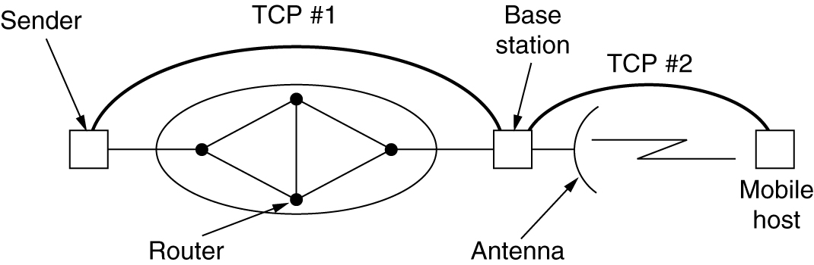
Splitting a TCP Connection into Two Connections
The indirect TCP solution (proposed by Bakne et al) is to split the TCP connection into two separate connections:
The first connection goes from the sender to the base station.
The second one goes from the base station to the receiver.
The base station simply copies packets between the two connections in both directions.
Timeouts on the first connection can slow down the sender, whereas timeouts on the second one can speed it up.
The problem with the indirect TCP approach is that it violates the semantics of TCP: receipt of an ack. by the sender does not mean that the receiver got the segment, only that the base station got it.

Slide 54
A Different Approach
A different approach by Balakrishnan et al (1995): it works by making several small modifications to the network layer code in the base station.
One change is the addition of a snooping agent that observes and caches TCP segments going out to the mobile host, and ack. coming back from it.
When the snooping agent sees a TCP segment going out to the mobile host but does not see an acknowledgment coming back before its (relatively short) timer goes off, it just retransmits that segment, without bothering the sender.
When it sees duplicate ack from the mobile host go by, invariably meaning that the mobile host has missed something, it also generates a retransmission and discards the duplicate ack, without bothering the sender.
When the base station notices a gap in the segment sequence number originating at the mobile host, it generates a request to the mobile host for a selective repeat of the missing byte using a TCP option.
In the above way, the wireless link is made more reliable in both directions, without the source sender knowing about it, and without changing the semantics of TCP.
Wireless communication also introduces difficulties for UDP. The main trouble is that programs using UDP expect it to be highly reliable, so cost for recovering from frequently lost packets can be very high.

